Slide 1
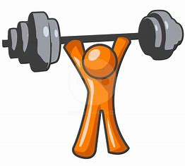
Muscle Strengthening
Dr Sarath Babu V
Professor cum Principal
Dept. of Sports Physiotherapy
MGM Institute Of Physiotherapy
Chh. Sambhajinagar

Slide 2
STRENGTH
Muscular strength is defined as a ability to generate force.
This force production typically involves an external resistance..

Slide 3
Strength
Muscle strength is a broad term that refers to the ability of contractile tissue to produce tension and a resultant force based on the demands placed on the muscle.
Muscle strength is the greatest measurable force that can be exerted by a muscle or muscle group to overcome resistance during a single maximum effort.

Slide 4
Functional strength relates to the ability of the neuromuscular system to produce, reduce, or control forces, contemplated or imposed, during functional activities, in a smooth, coordinated manner.

Slide 5
Strength training (strengthening exercise) is defined as a systematic procedure of a muscle or muscle group lifting, lowering, or controlling heavy loads (resistance) for a relatively low number of repetitions or over a short period of time.

Slide 6
Increase in strength and hypertrophy occur in response to an increase in intra muscular tension set up by the factors which oppose their contraction

Slide 7
At the beginning of treatment, assessment of the strength of the muscle is essential.

Slide 8
Factors determining skeletal muscle performance
Many factors affects skeletal muscle performance, such as muscle hypertrophy, size of motor unit, neuromuscular efficiency, biomechanics and gravity.

Slide 9
Muscular strength is directly proportional to the cross-sectional area of the muscle.
Cross sectional area of the muscle can be calculated by multiplying the length, the width, and the thickness of the muscle

Slide 10
Resistance training influences neuromuscular recruitment in 3 ways
-with training, the subject increases muscular efficiency by recruiting more motor units
-resistance training increases the firing rate of the motor nerve, therefore making motor unit recruitment occur more rapidly.
-strength training results in a more synchronous firing of the motor units, allowing the muscle to work more efficiently when completing activity.

Slide 11
Muscles are strongest in the middle of their functional range of motion.
Conversly, muscles are weakest at the end ranges of motion.

Slide 12
Power
Muscle power, another aspect of muscle performance, is related to the strength and speed of movement and is defined as the work (force × distance) produced by a muscle per unit of time (force × distance/time).
In other words, it is the rate of performing work.

Slide 13
The rate at which a muscle contracts and produces a resultant force and the relationship of force and velocity are factors that affect muscle power.

Slide 14
Power training
Many motor skills in our lives are composed of movements that are explosive and involve both strength and speed.
Therefore, re-establishing muscle power may be an important priority in a rehabilitation program.

Slide 15
Muscle strength is a necessary foundation for developing muscle power.
Power can be enhanced by either increasing the work a muscle must perform during a specified period of time or reducing the amount of time required to produce a given force.

Slide 16
The greater the intensity of the exercise and the shorter the time period taken to generate force, the greater is the muscle power.
For power training regimens, such as plyometric training or stretch-shortening drills, the speed of movement is the variable that is most often manipulated

Slide 18
Endurance
Endurance is a broad term that refers to the ability to perform low-intensity, repetitive, or sustained activities over a prolonged period of time.
Cardiopulmonary endurance (total body endurance) is associated with repetitive, dynamic motor activities, such as walking, cycling, swimming, or upper extremity ergometry, which involve use of the large muscles of the body

Slide 19
Muscle endurance (sometimes referred to as local endurance) is the ability of a muscle to contract repeatedly against a load (resistance), generate and sustain tension, and resist fatigue over an extended period of time.
The term aerobic power sometimes is used interchangeably with muscle endurance.
Maintenance of balance and proper alignment of the body segments requires sustained control (endurance) by the postural muscles.

Slide 20
work without excessive fatigue or potential injury

Slide 21
Endurance training
It is characterized by having a muscle contract and lift or lower a light load for many repetitions or sustain a muscle contraction for an extended period of time.
The key parameters of endurance training are low-intensity muscle contractions, a large number of repetitions, and a prolonged time period.
Unlike strength training, muscles adapt to endurance training by increases in their oxidative and metabolic capacities, which allows better delivery and use of oxygen.

Slide 22
Principles:
Overload,
SAID
Specificity
Reversibility
Detraining

Slide 23
Overload
If muscle performance is to improve, a load that exceeds the metabolic capacity of the muscle must be applied—that is, the muscle must be challenged to perform at a level greater than that to which it is accustomed.

Slide 24
If the demands remain constant after the muscle has adapted, the level of muscle performance can be maintained but not increased.

Slide 25
Application of the Overload Principle
The overload principle focuses on the progressive loading of muscle by manipulating, for example, the intensity or volume of exercise.

Slide 26
Intensity of resistance exercise refers to how much weight (resistance) is imposed on the muscle, whereas volume encompasses variables such as repetitions, sets, or frequency of exercise, any one or more of which can be gradually adjusted to increase the demands on the muscle.

Slide 27
In a strength training program, the amount of resistance applied to the muscle is incrementally and progressively increased.
For endurance training more endurance placed on the number of repetitions performed than on increasing resistance.

Slide 28
SAID Principle
The SAID principle (specific adaptation to imposed demands) suggests that a framework of specificity is a necessary foundation on which exercise programs should be built.
This principle applies to all body systems and is an extension of Wolff’s law (body systems adapt over time to the stresses placed on them).

Slide 29
The SAID principle helps therapists determine the exercise prescription and which parameters of exercise should be selected to create specific training effects that best meet specific functional needs and goals.

Slide 30
Specificity of Training
Specificity of training, also referred to as specificity of exercise, is a widely accepted concept suggesting that the adaptive effects of training, such as improvement of strength, power, and endurance, are highly specific to the training method employed.

Slide 31
Specificity of training also should be considered with respect to mode (type) and velocity of exercise as well as patient or limb position (joint angle) and the movement pattern during exercise.

Slide 32
Reversibility Principle
Adaptive changes in the body’s systems, such as increased strength or endurance, in response to a resistance exercise program are transient unless training-induced improvements are regularly used for functional activities or unless an individual participates in a maintenance program of resistance exercise.

Slide 33
Detraining
Detraining, reflected by a reduction in muscle performance, begins within a week or two after the cessation of resistance exercises and continues until training effects are lost.

Slide 34
For this reason, it is imperative that gains in strength and endurance are incorporated into daily activities as early as possible in a rehabilitation program.
It is also advisable for patients to participate in a maintenance program of resistance exercises as an integral component of a lifelong fitness program.

Slide 35
Intensity
The intensity of exercise in a resistance training program is the amount of resistance (weight) imposed on the contracting muscle during each repetition of an exercise.
The amount of resistance is also referred to as the exercise load (training load)—that is, the extent to which the muscle is loaded or Show much weight is lifted, lowered, or held.

Slide 36
One way to overload a muscle progressively is to gradually increase the amount of resistance used in the exercise program.
The intensity of exercise and the degree to which the muscle is overloaded is also dependent on the volume, frequency, and order of exercise or the length of rest intervals.

Slide 37
Motivation
If a resistance exercise program is to be effective, a patient must be willing to put forth and maintain sufficient effort and adhere to an exercise program over time to improve muscle performance for functional activities.
Use of activities that are meaningful and are perceived as having potential usefulness or periodically modifying an exercise routine help maintain a patient’s interest in resistance training.

Slide 38
Charting or graphing a patient’s strength gains, for example, also helps sustain motivation.
Incorporating gains in muscle performance into functional activities as early as possible in a resistance exercise program puts improvements in strength to practical use, thereby making those improvements meaningful.

Slide 39
Feedback
Feedback can have a positive impact on a patient’s motivation and subsequent adherence to an exercise program.
For example, some computerized equipment, such as isokinetic dynamometers, provide visual or auditory signals that let the patient know if each muscle contraction during a particular exercise is in a zone that causes a training effect.

Slide 40
Documenting improvements over time, such as the amount of weight (exercise load) used during various exercises or changes in walking distance or speed, also provides positive feedback to sustain a patient’s motivation in a resistance exercise program.

Slide 41
Alignment and Stabilization
Just as correct alignment and effective stabilization are basic elements of manual muscle testing and dynamometry, they are also crucial in resistance exercise.
To strengthen a specific muscle or muscle group effectively and avoid substitute motions, appropriate positioning of the body and alignment of a limb or body segment are essential.
Substitute motions are compensatory movement patterns caused by muscle action of a stronger adjacent agonist or a muscle group that normally serves as a stabilizer (fixator).

Slide 42
If the principles of alignment and stabilization for manual muscle testing are applied whenever possible during resistance exercise, substitute motions can usually be avoided.

Slide 43
Alignment
Alignment and muscle action. Proper alignment is determined by the direction of muscle fibers and the line of pull of the muscle to be strengthened.
The patient or a body segment must be positioned so the direction of movement of a limb or segment of the body replicates the action of the muscle or muscle groups to be strengthened.

Slide 44
Alignment and gravity. The alignment or position of the patient or the limb with respect to gravity also may be important during some forms of resistance exercises, particularly if body weight or free weights (dumbbells, barbells, cuff weights) are the source of resistance.

Slide 45
Stabilization
Stabilization refers to holding down a body segment or holding the body steady.
To maintain appropriate alignment, ensure the correct muscle action and movement pattern, and avoid unwanted substitute motions during resistance exercise, effective stabilization is imperative.
Exercising on a stable surface, such as a firm treatment table, helps hold the body steady.

Slide 46
Body weight also may provide a source of stability during exercise, particularly in the horizontal position.
It is most common to stabilize the proximal attachment of the muscle being strengthened, but sometimes the distal attachment is stabilized as the muscle contracts

Slide 47
External stabilization can be applied manually by the therapist.
Internal stabilization is achieved by an isometric contraction of an adjacent muscle group that does not enter into the movement pattern but holds the body segment of the proximal attachment of the muscle being strengthened firmly in place.

Slide 48
Potential Benefits of Resistance
Exercise
Enhanced muscle performance: restoration, improvement or maintenance of muscle strength, power, and endurance
Increased strength of connective tissues: tendons, ligaments, intramuscular connective tissue
Greater bone mineral density or less bone demineralization
Decreased stress on joints during physical activity
Reduced risk of soft tissue injury during physical activity

Slide 49
Possible improvement in capacity to repair and heal damaged soft tissues due to positive impact on tissue remodeling
Possible improvement in balance
Enhanced physical performance during daily living, occupational, and recreational activities

Slide 50
Positive changes in body composition: ↑ lean muscle mass or ↓ body fat
Enhanced feeling of physical well-being
Possible improvement in perception of disability and quality of life

Slide 51
Factors influencing the strength and endurance
factors that influence the force-producing capacity of normal muscle during an active contraction is fundamental to understanding how the neuromuscular system adapts as the result of resistance training.

Slide 52
Diverse but interrelated factors affect the tension-generating capacity of normal skeletal muscle necessary to control the body and perform motor tasks.
Determinants and correlates include morphological, biomechanical, neurological, metabolic, and biochemical factors.
All contribute to the magnitude, duration, and speed of force production as well as how resistant or susceptible a muscle is to fatigue.
Properties of muscle itself and as key neural factors and their impact on tension generation during an active muscle contraction.

Slide 53
Additional factors—such as the energy stores available to muscle, the influence of fatigue and recovery from exercise, and a person’s age, gender, and psychological/cognitive status, as well as many other factors—affect a muscle’s ability to develop and sustain tension.

Slide 54
Factors that Influence Tension
Generation in Normal Skeletal Muscle
Cross-section and size of the muscle (includes muscle fiber number and size)--The larger the muscle diameter, the greater its tension-producing capacity.

Slide 55
Muscle architecture—fiber arrangement and fiber length --Short fibers with pinnate and multipinnate design in high force-producing muscles (ex. quadriceps, gastrocnemius,deltoid, biceps brachii).
--Long, parallel design in muscles with high rate of shortening but less force production (ex. sartorius, lumbricals).

Slide 56
Fiber-type distribution of muscle—type I (tonic,slow-twitch) and type IIA & IIB (phasic, fast-twitch)
--High percentage of type I fibers—low force production, slow rate of maximum force development, resistant to fatigue.
--High percentage of type IIA and IIB fibers—rapid high force production; rapid fatigue.

Slide 57
Length-tension relationship of muscle at time of contraction -- Muscle produces greatest tension when it is near or at the physiological resting length at the time of contraction.

Slide 58
Recruitment of motor units
--The greater the number and synchronization of motor units firing, the greater the force production.

Slide 59
Frequency of firing of motor units
-- The higher the frequency of firing, the greater the tension.

Slide 60
Type of muscle contraction
--Force output from greatest to least—eccentric, isometric,concentric muscle contraction.

Slide 61
Speed of muscle contraction (force-velocity relationship)
--Concentric contraction: ↑ speed →↓ tension. Eccentric contraction: ↑ speed → ↑ tension.

Slide 62
Energy Stores and Blood Supply
Muscle needs adequate sources of energy (fuel) to contract,generate tension, and resist fatigue.
The predominant fiber type found in the muscle and the adequacy of blood supply, which transports oxygen and nutrients to muscle and removes waste products, affect the tension-producing capacity of a muscle and its resistance to fatigue..

Slide 63
Fatigue
Fatigue is a complex phenomenon that affects muscle performance and must be considered in a resistance exercise program.
Muscle (local) fatigue.
Cardiopulmonary (general) fatigue.

Slide 64
Muscle (local) fatigue.
Most relevant to resistance exercise is the phenomenon of skeletal muscle fatigue.
Muscle (local)fatigue—the diminished response of muscle to a repeatedstimulus—is reflected in a progressive decrement in the amplitude of motor unit potentials.
This occurs during exercise when a muscle repeatedly contracts statically or dynamically against an imposed load.

Slide 65
Signs and Symptoms of Muscle Fatigue
An uncomfortable sensation in the muscle, even pain and cramping
Tremulousness in the contracting muscle
An unintentional slowing of movement with successive repetitions of an exercise
Active movements: jerky, not smooth

Slide 66
Inability to complete the movement pattern through the full range of available motion during dynamic exercise against the same level of resistance
Use of substitute motions—that is, incorrect movement patterns—to complete the movement pattern
Inability to continue low-intensity physical activity
Decline in peak torque during isokinetic testing

Slide 67
Cardiopulmonary (general) fatigue.
It is the diminished response of an individual (the entire body) as the result of prolonged physical activity, such as walking, jogging, cycling, or repetitive lifting or digging.
It is related to the body’s ability to use oxygen efficiently.
Cardiopulmonary fatigue associated with endurance training is probably caused by a combination of the some factors..
Decrease in blood sugar (glucose) levels.
Decrease in glycogen stores in muscle and liver.
Depletion of potassium, especially in the elderly patient.

Slide 68
Recovery from Exercise
Adequate time for recovery from fatiguing exercise must be built into every resistance exercise program. This applies to both intrasession and intersession recovery.

Slide 69
Recovery from acute exercise, in which the force-producing capacity of muscle returns to 90% to 95% of the pre-exercise capacity, usually takes 3 to 4 minutes, with the greatest proportion of recovery occurring in the first minute.
During recovery oxygen and energy stores are replenished quickly in muscles. Lactic acid is removed from skeletal muscle and blood within approximately 1 hour after exercise, and glycogen is replaced over several days.

Slide 70
Age
Muscle performance changes throughout the life span.
Whether the goal of a resistance training program is to remediate impairments and activity limitations (functional limitations) or enhance fitness and performance of physical activities, an understanding of “typical” changes in muscle performance and response to exercise during each phase of life from early childhood through the advanced years of life is necessary to prescribe effective, safe resistance exercises for individuals of all ages.

Slide 71
Psychological and Cognitive Factors
An array of psychological factors can positively or negatively influence muscle performance and how easily, vigorously, or cautiously a person moves.
Just as injury and disease adversely affect muscle performance, so can a person’s mental status.
For example, fear of pain, injury, or re-injury, depression related to physical illness, or impaired attention or memory as the result of age, head injury, or the side effects of medication can adversely affect the ability to develop or sustain sufficient muscle tension for execution or acquisition of functional motor tasks.
In contrast, psychological factors can positively influence physical performance

Slide 72
Attention
A patient must be able to focus on a given task (exercise) to learn how to perform it correctly.
Attention involves the ability to process relevant data while screening out irrelevant information from the environment and to respond to internal cues from the body.

Slide 73
Motivation and Feedback
If a resistance exercise program is to be effective, a patient must be willing to put forth and maintain sufficient effort and adhere to an exercise program over time to improve muscle performance for functional activities.

Slide 74
Determinants of a Resistance
Exercise Program
Alignment of segments of the body during exercise
Stabilization of proximal or distal joints to prevent substitution
Intensity: the exercise load (level of resistance)

Slide 75
Volume: the total number of repetitions and sets in an exercise session
Exercise order: the sequence in which muscle groups are exercised during an exercise session
Frequency: the number of exercise sessions per day or per week

Slide 76
Rest interval: time allotted for recuperation between sets and sessions of exercise
Duration: total time frame of a resistance training program
Mode of exercise: type of muscle contraction, position of the patient, form (source) of resistance, arc of movement, or the primary energy system utilized

Slide 77
Velocity of exercise
Periodization: variation of intensity and volume during specific periods of resistance training
Integration of exercises into functional activities: use of resistance exercises that approximate or replicate functional demands

Slide 78
Intensity
The intensity of exercise in a resistance training program is the amount of resistance (weight) imposed on the contracting muscle during each repetition of an exercise.
The amount of resistance is also referred to as the exercise load (training load)—that is, the extent to which the muscle is loaded or how much weight is lifted, lowered, or held.

Slide 79
The overload principle, to improve muscle performance the muscle must be loaded to an extent greater than loads usually incurred.
One way to overload a muscle progressively is to gradually increase the amount of resistance used in the exercise program.
The intensity of exercise and the degree to which the muscle is overloaded is also dependent on the volume, frequency, and order of exercise or the length of rest intervals.

Slide 80
Submaximal Versus Maximal Exercise Loads
Indications for submaximal loading for moderate to low intensity exercise versus near-maximal or maximal loading for high-intensity exercise.

Slide 81
Initial Exercise Load (Amount of Resistance)and Documentation of Training Effects
It is always challenging to estimate how much resistance to apply manually or how much weight a patient should use during resistance exercises to improve muscle strength particularly at the beginning of a strengthening program.

Slide 82
Repetition Maximum
One method of measuring the effectiveness of a resistance exercise program and calculating an appropriate exercise load for training is to determine a repetition maximum.
This term was first reported decades ago by DeLorme in his investigations of an approach to resistance training called progressive resistive exercise (PRE).

Slide 83
A repetition maximum (RM) is defined as the greatest amount of weight (load) a muscle can move through the full, available ROM with control a specific number of times before fatiguing.

Slide 84
Use of a repetition maximum.
There are two main reasons for determining a repetition maximum:
(1) to document a baseline measurement of the dynamic strength of a muscle or muscle group against which exercise-induced improvements in strength can be compared;
(2) to identify an initial exercise load (amount of weight) to be used during exercise for a specified number of repetitions.

Slide 85
DeLorme reported use of a 1-RM (the greatest amount of weight a subject can move through the available ROM just one time) as the baseline measurement of a subject’s maximum effort but used a multiple RM, specifically a 10-RM, (the amount of weight that could be lifted and lowered 10 times through the ROM) during training.

Slide 86
Alternative Methods of Determining Baseline
Strength or an Initial Exercise Load
Cable tensiometry and isokinetic or handheld dynamometry are alternatives to a repetition maximum for establishing a baseline measurement of dynamic or static strength.
A percentage of body weight also has been proposed to estimate how much resistance (load) should be used in a strength training program.

Slide 87
Percentage of Body Weight as an Initial Exercise Load for Selected Exercises
Universal bench press: 30% body weight
Universal leg extension: 20% body weight
Universal leg curl: 10% to 15% body weight
Universal leg press: 50% body weight

Slide 88
After establishing the baseline RM, the amount of resistance (exercise load) to be used at the initiation of resistance training often is calculated as a percentage of a 1-RM for a particular muscle group.
At the beginning of an exercise program the percentage necessary to achieve training-induced adaptations in strength is low (30% to 40%) for sedentary, untrained individuals or very high (>80%) for those already highly trained.

Slide 89
For healthy but untrained adults, a typical training zone usually falls between 40% and 70% of the baseline RM.
The lower percentage of this range is safer at the beginning of a program to enable an individual to focus on learning correct exercise form and technique before progressing the exercise load to 60% to 70%.

Slide 90
For patients with significant deficits in muscle strength or to train for muscular endurance, using a low load—possibly at the 30% to 50% level—is safe yet challenging.

Slide 91
Progressive Resistance Exercise
PRE is a system of dynamic resistance training in which a constant external load is applied to the contracting muscle by some mechanical means (usually a free weight or weight machine) and incrementally increased.
The RM is used as the basis for determining and progressing the resistance.

Slide 92
It is indicated that PRE also was beneficial for patients with a variety of pathological conditions including musculoskeletal injuries, osteoarthritis, osteoporosis, hypertension, adult onset (type II) diabetes, and chronic obstructive pulmonary disease.

Slide 93
Delorme and Oxford Regimens
The concept of PRE was introduced over 60 years ago by DeLorme, who originally used the term heavy resistance training and later load-resisting exercise to describe a new system of strength training.
DeLorme proposed and studied the use of three sets of a percentage of a 10-RM with progressive loading during each set.
Other investigators developed a regimen, the Oxford technique, with regressive loading in each set,

Slide 94
Comparison of Two PRE Regimens
DeLorme Regimen
Determination of a 10-RM
10 reps @ 50% of the 10-RM
10 reps @ 75% of the 10-RM
10 reps @ 100% of the 10-RM
Oxford Regimen
Determination of a 10-RM
10 reps @ 100% of the 10-RM
10 reps @ 75% of the 10-RM
10 reps @ 50% of the 10-RM

Slide 95
DAPRE Regimen
A common guideline is to increase the weight by 5% to 10% when all prescribed repetitions and sets can be completed easily without significant fatigue.
The Daily Adjustable Progressive Resistive Exercise (DAPRE) technique is more systematic and takes into account the different rates at which individuals progress during rehabilitation or conditioning programs.

Slide 96
DAPRE Technique
Sets Repetitions Amount of Resistance
10 50% 6-RM*
6 75% 6-RM
Maximum possible 100% 6-RM
Maximum possible 100% adjusted working
weight

Slide 97
Equipments
the choice of equipment depends primarily on the individual needs, abilities, and goals of the person using the equipment.
Other factors that influence the choice of equipment are the availability; the cost of purchase or maintenance by a facility or a patient; the ease of use (application or setup) of the equipment; the versatility of the equipment; and the space requirements of the equipment.
Once the appropriate equipment has been selected, its safe and effective use is the highest priority

Slide 98
Free Weights and Simple
Weight-Pulley Systems
Types of Free Weights
Free weights are graduated weights that are handheld or applied to the upper and lower extremities or trunk.
They include commercially available dumbbells, barbells, weighted balls, cuff weights, weighted vests, and even sandbags.
Free weights also can be fashioned for a home exercise program from readily available materials and objects found around the home.

Slide 99
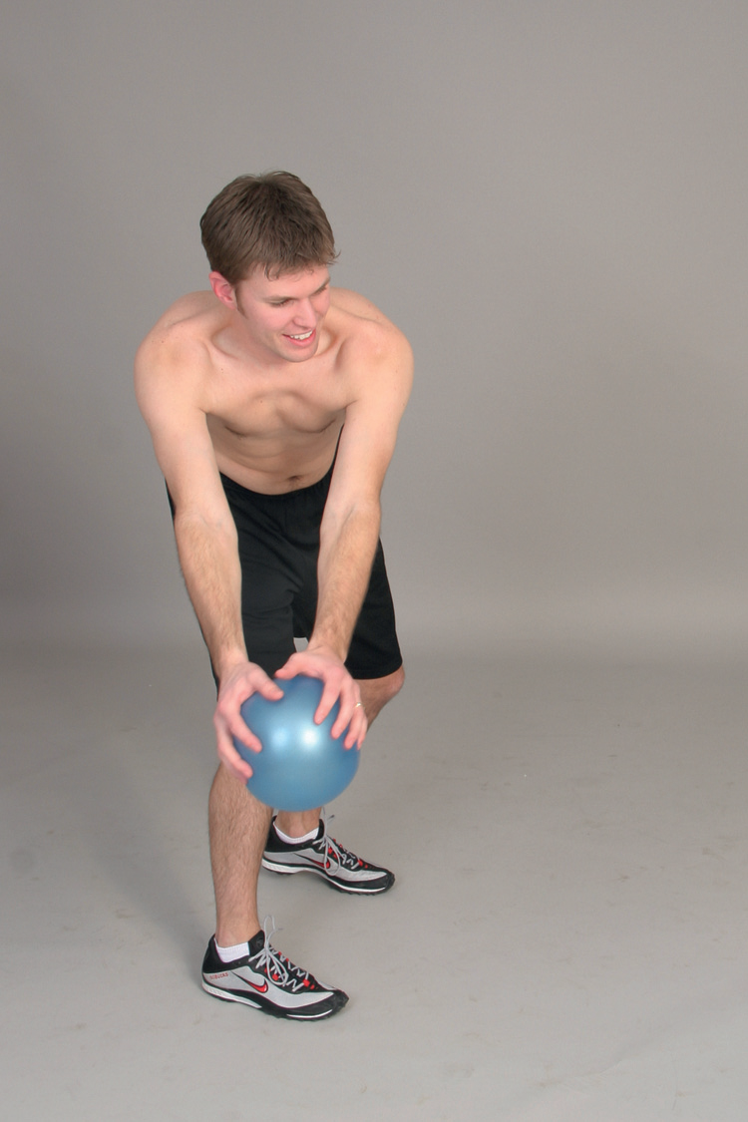
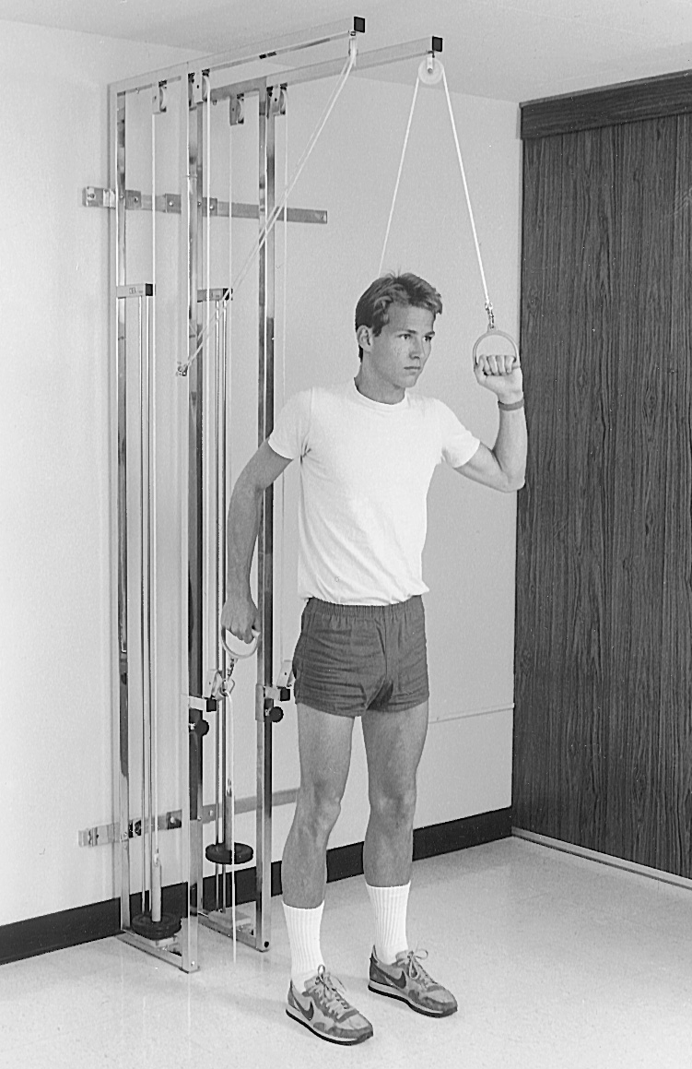

Slide 100
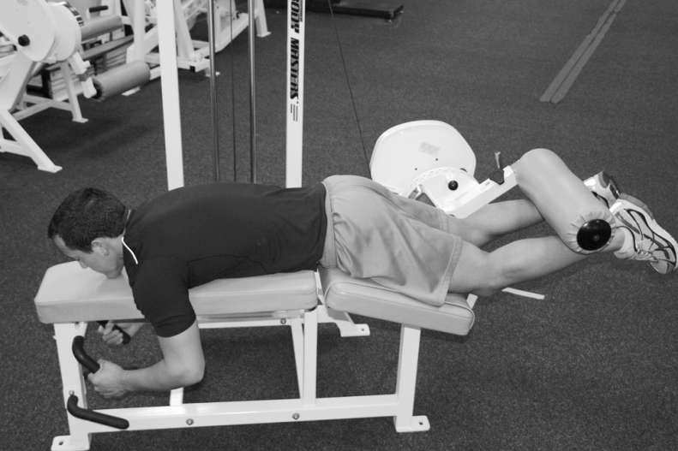
Variable Resistance Units
Variable Resistance Weight-Cable Systems
Variable resistance weight-cable machines use a cam in their design.
The cam (an elliptical or kidney-shaped disk) in the weight-cable system is designed to vary the load (torque) applied to the contracting muscle even though the weight selected remains the same.

Slide 101
Elastic Resistance Devices
The use of elastic resistance products in therapeutic exercise programs has become widespread in rehabilitation and has been shown to be an effective method of providing sufficient resistance to improve muscle strength.
Resistance training with elastic products also has been shown to be a feasible alternative to training with weight machines and free weights, generating comparably high levels of muscle activation during exercises.

Slide 102
Types of Elastic Resistance
Elastic resistance products, specifically designed for use during exercise, fall into two broad categories: elastic bands and elastic tubing

